Slide 1

Red Team Project SimCorp

Slide 2

Agenda
Team Member Introductions
SimCorp
Red team objectives
Important vulnerabilities
Q&A
Notes:
The primary driver of the presentation should take a moment to discuss the agenda for the presentation.
Ultimately, your team’s agenda shouldn’t stray from this template too much.

Slide 3

Our Team
André Graça
Cristiano Garcia
Rodrigo Brasil
Notes:
Show the whole team here in whatever creative way that align’s with your project’s branding or theme.
Update the stock silhouette image with a picture of you and your team.
Add each team member name, with the primary "driver" of the presentation as the first team member. This person should say a word or 2 about the team and subsequently move into the next slide, where they will begin their personal pitches.

Slide 4


André Graça
Age: 40
Place of birth: Lisbon
Married with 3 children
Member of the Portuguese Navy since November 2001
Specialized in Computer Technician and network administration in 2013 by the Navy.
Specialized in cybersecurity in the area of offensive operations in 2023 by the EMGFA (General Staff of the Armed Forces) in partnership with the Polytechnic Institute of Beja.
Notes:
Copy this slide for each member of your group.
Update the stock silhouette image to your professional headshot.
Update the title to the appropriate team member's name.
Insert a bulleted summary of your personal pitch using key words.
Practice your personal pitch several times prior to the presentation.
Remain calm and speak with confidence.
Your pitch should be about 60 seconds long.
End it with a mic drop closing statement!
Remember to announce that you will be passing the mic to the next speaker.

Slide 5
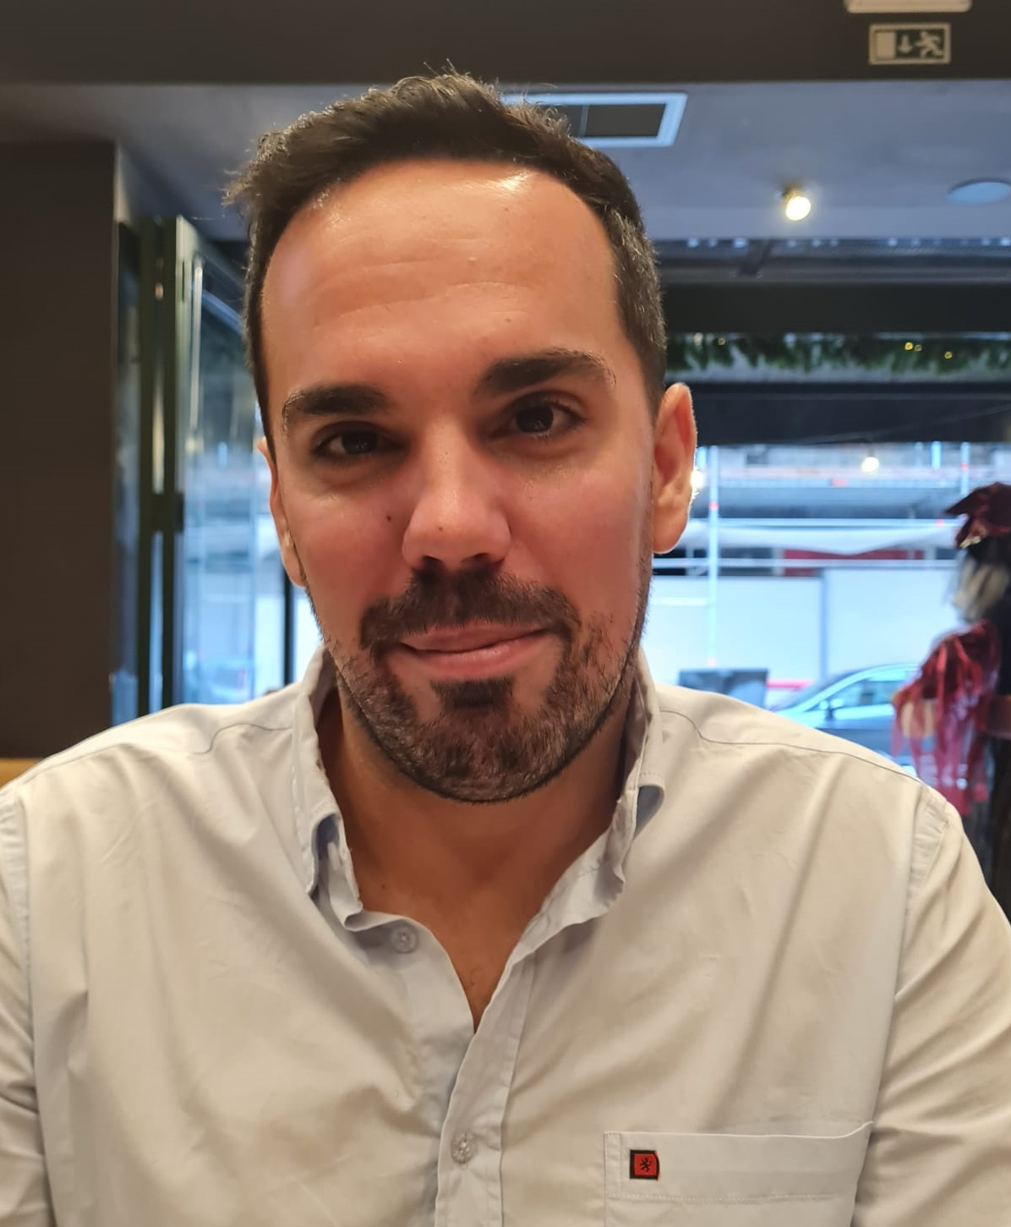

Cristiano Garcia
Age: 34
Place of birth: Castelo Branco
Professional Firefighter
Pre-hospital emergency technician
Passion about IT and Cybersecurity
Notes:
Copy this slide for each member of your group.
Update the stock silhouette image to your professional headshot.
Update the title to the appropriate team member's name.
Insert a bulleted summary of your personal pitch using key words.
Practice your personal pitch several times prior to the presentation.
Remain calm and speak with confidence.
Your pitch should be about 60 seconds long.
End it with a mic drop closing statement!
Remember to announce that you will be passing the mic to the next speaker.

Slide 6


Rodrigo Brasil
Age: 24
Place of birth: Angra do Heroismo
IT Technician
Notes:
Copy this slide for each member of your group.
Update the stock silhouette image to your professional headshot.
Update the title to the appropriate team member's name.
Insert a bulleted summary of your personal pitch using key words.
Practice your personal pitch several times prior to the presentation.
Remain calm and speak with confidence.
Your pitch should be about 60 seconds long.
End it with a mic drop closing statement!
Remember to announce that you will be passing the mic to the next speaker.

Slide 7

SimCorp
Kalimeros was contracted by Simcorp to conduct a penetration test in order to determine its exposure on the network. All activities were conducted in a manner that simulated a malicious actor engaged in a targeted attack against SimCorp.
Efforts were placed on the identification and exploitation of security weaknesses that could allow a remote attacker to gain unauthorized access to organizational data.
Notes:
Teams will break up into individual demos. More than one person may demo the same solution together if they worked together on it.
Each presenter(s) will duplicate and create their own Solutions, Topology and Demo slides. Each presenter(s) will introduce their client’s problem in depth, explain your solution, show us a visual of how it works and then demo out your solution before passing it on to the next presenter.
Introduce your team’s client company and their problem domain.
Quickly introduce your client company and what kind of industry they are from.
Did you make your client company a logo? a mission statement?
Great creative with this part!
Briefly list the problems the client company is having.
Save the details of these problems for the Solutions slide!
Distinguish between the problems the company asked for help with and any other solutions your team found that the client would benefit from.
“While we were working to meet the client’s needs, we also notice they would benefit from a few upgrades such as…”

Slide 8
Red Team Objectives
RTO1. Enumerate the target network, gathering as much information as possible about the various hosts and their configurations.
RTO1a. Create a professional network topology of the target environment for inclusion in your final report.
RTO2. Discover vulnerabilities on targets hosts on the network.
RTO3. Build/customize and utilize at least one custom Python tool.
RTO4. Exploit and gain access to as many host instances as possible.
Notes:
Teams will break up into individual demos. More than one person may demo the same solution together if they worked together on it.
Each presenter(s) will duplicate and create their own Solutions, Topology and Demo slides. Each presenter(s) will introduce their client’s problem in depth, explain your solution, show us a visual of how it works and then demo out your solution before passing it on to the next presenter.
Introduce your team’s client company and their problem domain.
Quickly introduce your client company and what kind of industry they are from.
Did you make your client company a logo? a mission statement?
Great creative with this part!
Briefly list the problems the client company is having.
Save the details of these problems for the Solutions slide!
Distinguish between the problems the company asked for help with and any other solutions your team found that the client would benefit from.
“While we were working to meet the client’s needs, we also notice they would benefit from a few upgrades such as…”

Slide 9
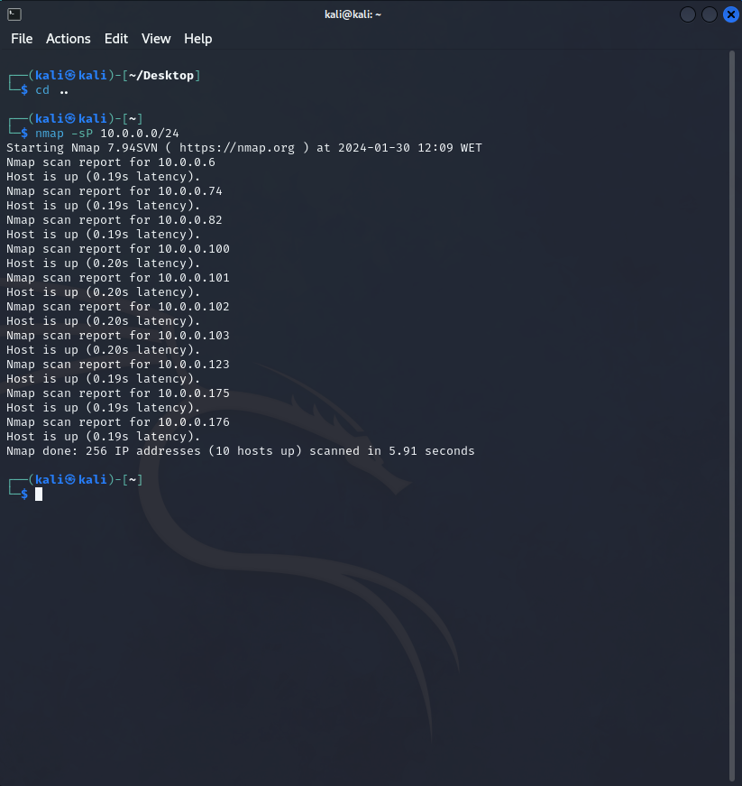
Host Enumeration
Enumerating the target network.
Proceeding to discover vulnerabilities with Nessus and Nmap.
Rules applied and didn't exploit hosts 10.0.0.6 (Splunk) and 10.0.0.176 (OpenVpn).

Slide 10
Vulnerabilities found on the SimCorp network
Vulnerabilities
TTP´S
NFS Exported Share Information Disclosure
Microsoft RDP RCE (CVE-2019-0708)
SSH Terrapin Prefix Truncation Weakness (CVE-2023-48795)
File and Directory Permissions Modification
Remote Services: Remote Desktop Protocol
Brute Force

Slide 11
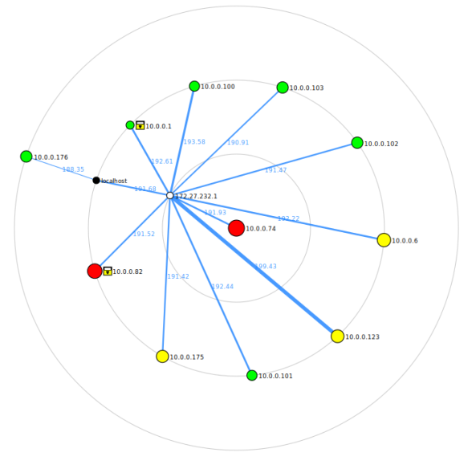
Topologies and Flowcharts
Notes:
Include a screenshot of the topology or other flow charts your team created. Calmly using your mouse, walk us through your topology and explain each step your solution is going to take.
One screenshot per slide.
Blow it up so the audience can see the details.
Duplicate this slide as many times as necessary.
Don’t forget:
Teams will break up into individual demos. More than one person may demo the same solution together if they worked together on it.
Each presenter(s) will duplicate and create their own Solutions, Topology and Demo slides. Each presenter(s) will introduce their client’s problem in depth, explain your solution, show us a visual of how it works and then demo out your solution before passing it on to the next presenter.

Slide 12
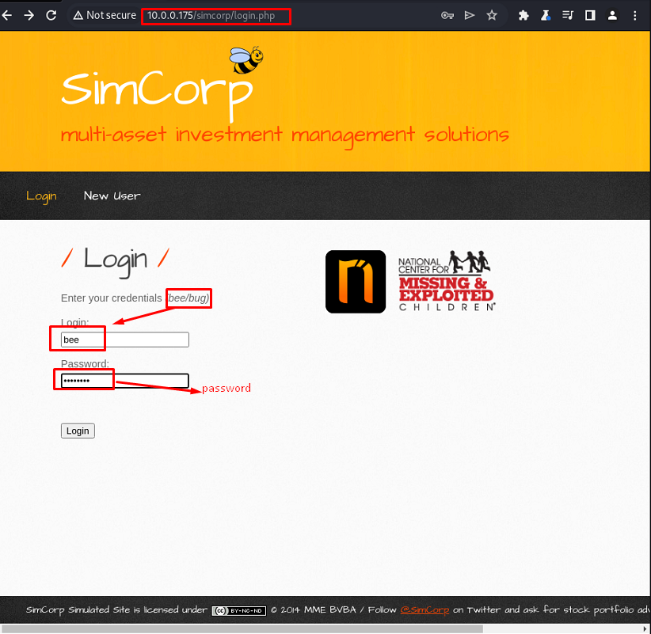
Vulnerabilities found on the SimCorp network
one of the vulnerabilities found was on SamCorp's website where a user is exposed and all it took was brute force to log in to the page.
Notes:
Teams will break up into individual demos. More than one person may demo the same solution together if they worked together on it.
Each presenter(s) will duplicate and create their own Solutions, Topology and Demo slides. Each presenter(s) will introduce their client’s problem in depth, explain your solution, show us a visual of how it works and then demo out your solution before passing it on to the next presenter.
Introduce your team’s client company and their problem domain.
Quickly introduce your client company and what kind of industry they are from.
Did you make your client company a logo? a mission statement?
Great creative with this part!
Briefly list the problems the client company is having.
Save the details of these problems for the Solutions slide!
Distinguish between the problems the company asked for help with and any other solutions your team found that the client would benefit from.
“While we were working to meet the client’s needs, we also notice they would benefit from a few upgrades such as…”

Slide 13
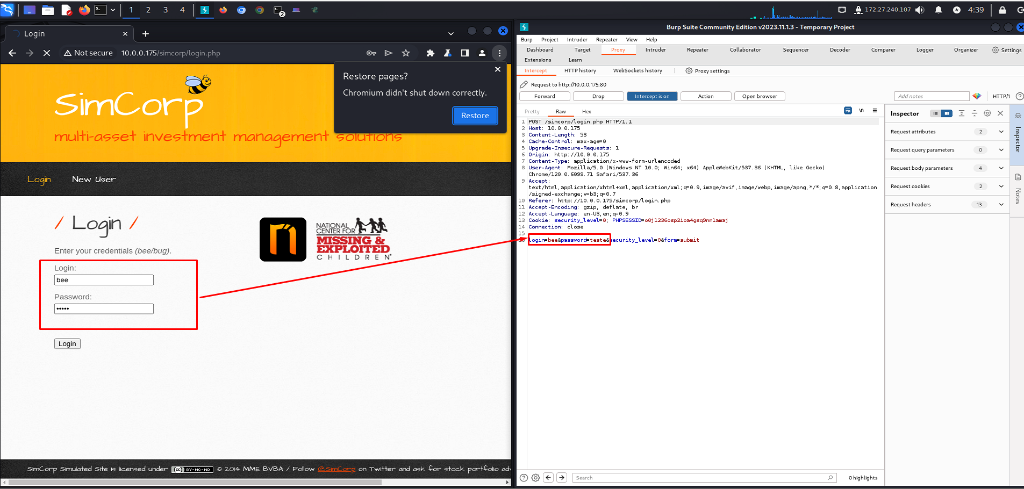
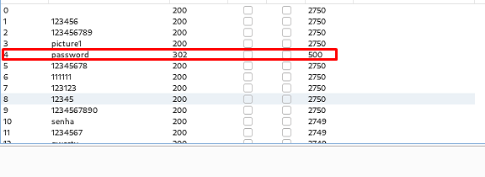
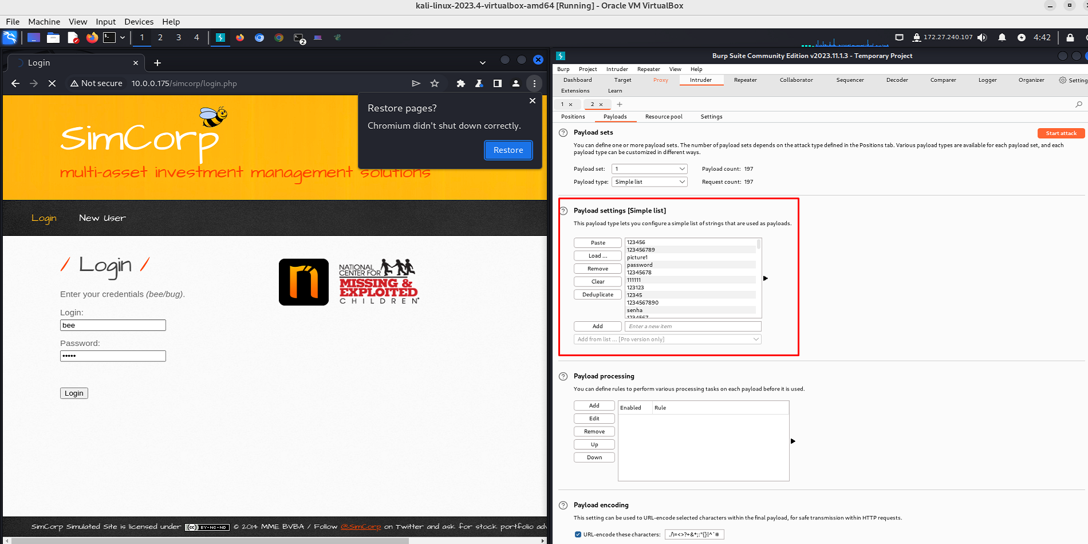
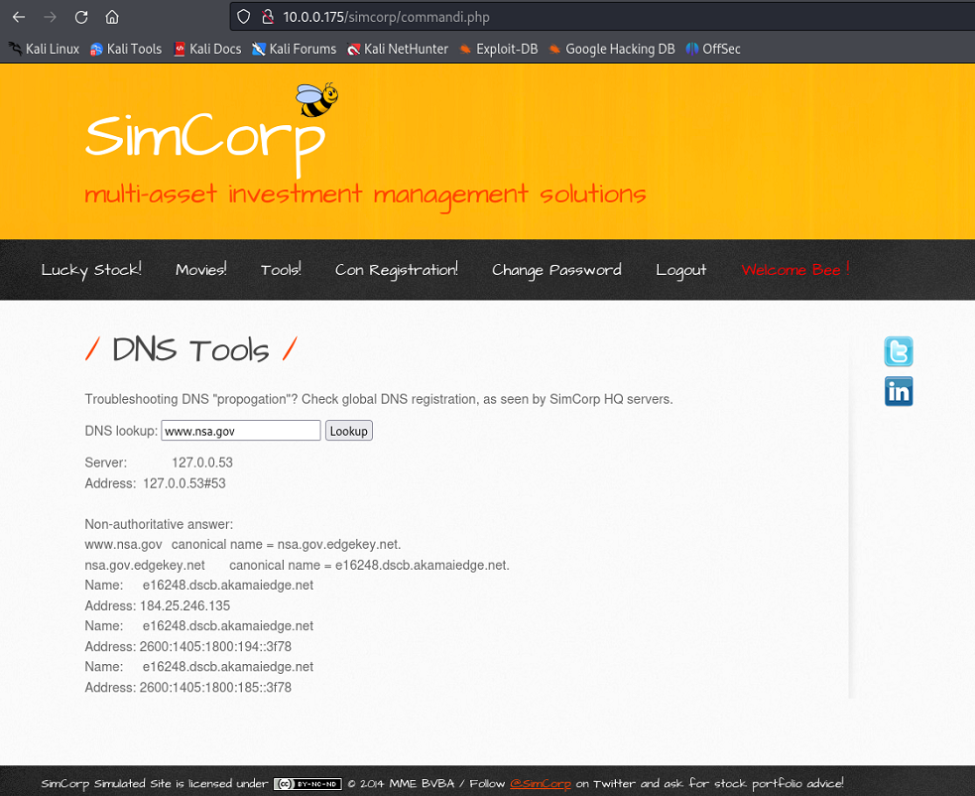
The Burp Suite application was used for this task.

Slide 14
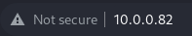


HTTP
After the enumeration phase each one of us was tasked to deal with an host we found to be of value exploit.
I was tasked with the host 10.0.0.82.
Notes:
Teams will break up into individual demos. More than one person may demo the same solution together if they worked together on it.
Each presenter(s) will duplicate and create their own Solutions, Topology and Demo slides. Each presenter(s) will introduce their client’s problem in depth, explain your solution, show us a visual of how it works and then demo out your solution before passing it on to the next presenter.
Introduce your team’s client company and their problem domain.
Quickly introduce your client company and what kind of industry they are from.
Did you make your client company a logo? a mission statement?
Great creative with this part!
Briefly list the problems the client company is having.
Save the details of these problems for the Solutions slide!
Distinguish between the problems the company asked for help with and any other solutions your team found that the client would benefit from.
“While we were working to meet the client’s needs, we also notice they would benefit from a few upgrades such as…”

Slide 15
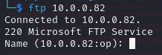
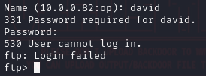
FTP
Spending a bit of time on the web app and not getting anywhere we decided to try something else.
Notes:
Teams will break up into individual demos. More than one person may demo the same solution together if they worked together on it.
Each presenter(s) will duplicate and create their own Solutions, Topology and Demo slides. Each presenter(s) will introduce their client’s problem in depth, explain your solution, show us a visual of how it works and then demo out your solution before passing it on to the next presenter.
Introduce your team’s client company and their problem domain.
Quickly introduce your client company and what kind of industry they are from.
Did you make your client company a logo? a mission statement?
Great creative with this part!
Briefly list the problems the client company is having.
Save the details of these problems for the Solutions slide!
Distinguish between the problems the company asked for help with and any other solutions your team found that the client would benefit from.
“While we were working to meet the client’s needs, we also notice they would benefit from a few upgrades such as…”

Slide 16
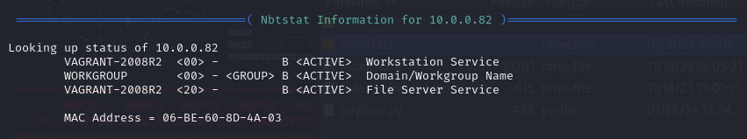
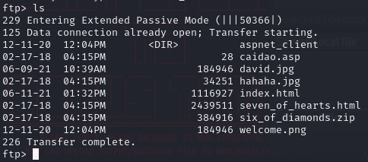
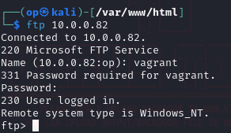
FTP
Notes:
Teams will break up into individual demos. More than one person may demo the same solution together if they worked together on it.
Each presenter(s) will duplicate and create their own Solutions, Topology and Demo slides. Each presenter(s) will introduce their client’s problem in depth, explain your solution, show us a visual of how it works and then demo out your solution before passing it on to the next presenter.
Introduce your team’s client company and their problem domain.
Quickly introduce your client company and what kind of industry they are from.
Did you make your client company a logo? a mission statement?
Great creative with this part!
Briefly list the problems the client company is having.
Save the details of these problems for the Solutions slide!
Distinguish between the problems the company asked for help with and any other solutions your team found that the client would benefit from.
“While we were working to meet the client’s needs, we also notice they would benefit from a few upgrades such as…”

Slide 17
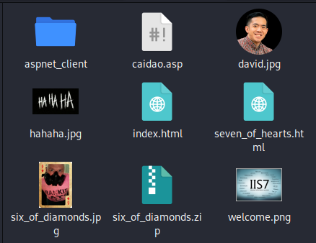
FTP
Notes:
Teams will break up into individual demos. More than one person may demo the same solution together if they worked together on it.
Each presenter(s) will duplicate and create their own Solutions, Topology and Demo slides. Each presenter(s) will introduce their client’s problem in depth, explain your solution, show us a visual of how it works and then demo out your solution before passing it on to the next presenter.
Introduce your team’s client company and their problem domain.
Quickly introduce your client company and what kind of industry they are from.
Did you make your client company a logo? a mission statement?
Great creative with this part!
Briefly list the problems the client company is having.
Save the details of these problems for the Solutions slide!
Distinguish between the problems the company asked for help with and any other solutions your team found that the client would benefit from.
“While we were working to meet the client’s needs, we also notice they would benefit from a few upgrades such as…”

Slide 18
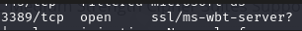
RDP
During the enumeration phase we didn't notice on two of the hosts there was a RDP port open until we made a nessus vulnerabilities scan.
Notes:
Teams will break up into individual demos. More than one person may demo the same solution together if they worked together on it.
Each presenter(s) will duplicate and create their own Solutions, Topology and Demo slides. Each presenter(s) will introduce their client’s problem in depth, explain your solution, show us a visual of how it works and then demo out your solution before passing it on to the next presenter.
Introduce your team’s client company and their problem domain.
Quickly introduce your client company and what kind of industry they are from.
Did you make your client company a logo? a mission statement?
Great creative with this part!
Briefly list the problems the client company is having.
Save the details of these problems for the Solutions slide!
Distinguish between the problems the company asked for help with and any other solutions your team found that the client would benefit from.
“While we were working to meet the client’s needs, we also notice they would benefit from a few upgrades such as…”

Slide 19
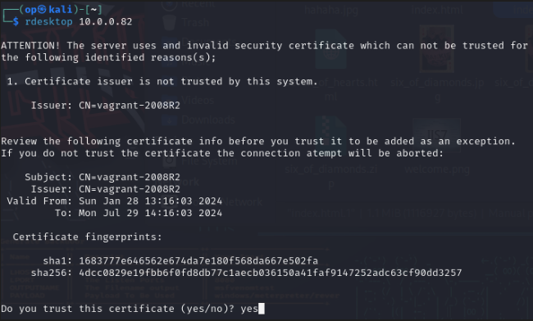
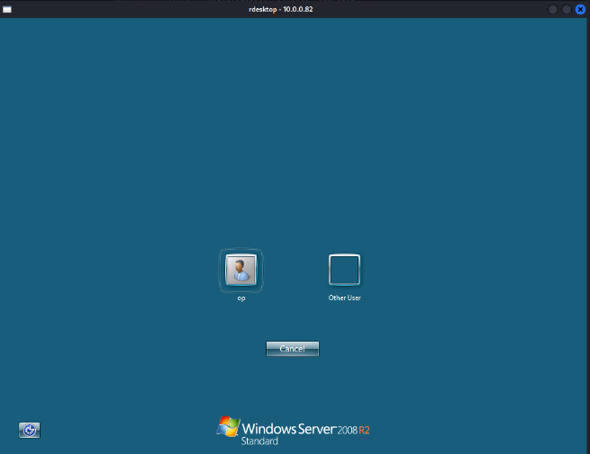
RDP
Notes:
Teams will break up into individual demos. More than one person may demo the same solution together if they worked together on it.
Each presenter(s) will duplicate and create their own Solutions, Topology and Demo slides. Each presenter(s) will introduce their client’s problem in depth, explain your solution, show us a visual of how it works and then demo out your solution before passing it on to the next presenter.
Introduce your team’s client company and their problem domain.
Quickly introduce your client company and what kind of industry they are from.
Did you make your client company a logo? a mission statement?
Great creative with this part!
Briefly list the problems the client company is having.
Save the details of these problems for the Solutions slide!
Distinguish between the problems the company asked for help with and any other solutions your team found that the client would benefit from.
“While we were working to meet the client’s needs, we also notice they would benefit from a few upgrades such as…”

Slide 20
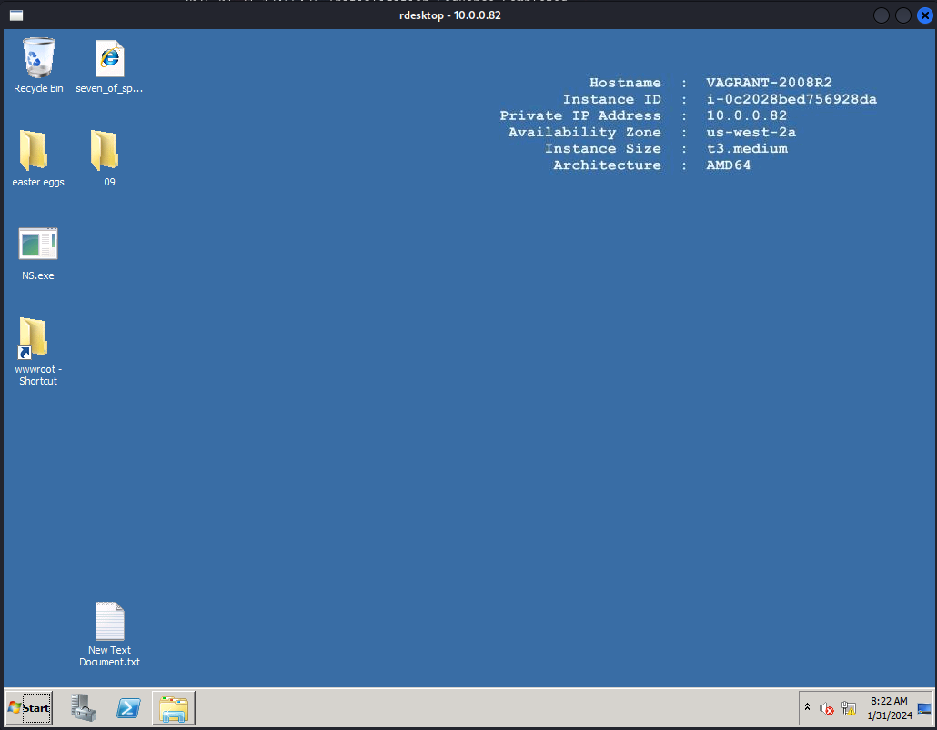
RDP
Notes:
Teams will break up into individual demos. More than one person may demo the same solution together if they worked together on it.
Each presenter(s) will duplicate and create their own Solutions, Topology and Demo slides. Each presenter(s) will introduce their client’s problem in depth, explain your solution, show us a visual of how it works and then demo out your solution before passing it on to the next presenter.
Introduce your team’s client company and their problem domain.
Quickly introduce your client company and what kind of industry they are from.
Did you make your client company a logo? a mission statement?
Great creative with this part!
Briefly list the problems the client company is having.
Save the details of these problems for the Solutions slide!
Distinguish between the problems the company asked for help with and any other solutions your team found that the client would benefit from.
“While we were working to meet the client’s needs, we also notice they would benefit from a few upgrades such as…”

Slide 21






Resources & Thanks

Slide 22
Questions?

